Slide 1
C#

Slide 2
OOP
OOP stands for Object-Oriented Programming.
Procedural programming is about writing procedures or methods that perform operations on the data, while object-oriented programming is about creating objects that contain both data and methods.
Object-oriented programming has several advantages over procedural programming:
OOP is faster and easier to execute
OOP provides a clear structure for the programs
OOP helps to keep the C# code DRY "Don't Repeat Yourself", and makes the code easier to maintain, modify and debug
OOP makes it possible to create full reusable applications with less code and shorter development time

Slide 3
What are Classes and Objects?
Classes and objects are the two main aspects of object-oriented programming.
Look at the following illustration to see the difference between class and objects:
So, a class is a template for objects, and an object is an instance of a class.
When the individual objects are created, they inherit all the variables and methods from the class.
class
Fruit
class
Car
Apple
Banana
Mongo
Volvo
Audi
Ford
objects
objects

Slide 4
Classes and Objects
Everything in C# is associated with classes and objects, along with its attributes and methods. For example: in real life, a car is an object. The car has attributes, such as weight and color, and methods, such as drive and brake.
A Class is like an object constructor, or a "blueprint" for creating objects.

Slide 5
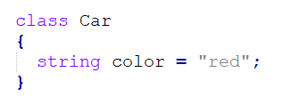
Create a Class
To create a class, use the class keyword.
Create a class named Car with a variable color:

Slide 6
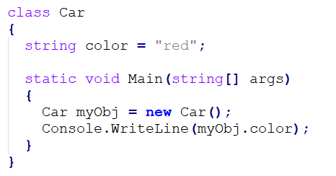
Create an Object
An object is created from a class. We have already created the class named Car, so now we can use this to create objects.
To create an object of Car, specify the class name, followed by the object name, and use the keyword new.
Create an object named myObj and use it to print the value of color:

Slide 7
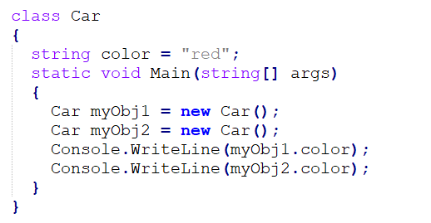
Multiple Objects
You can create multiple objects of one class:

Slide 8
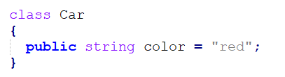
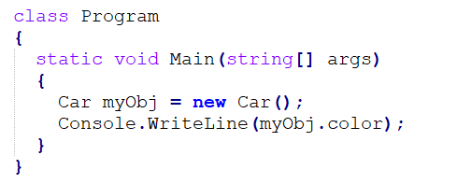
Using Multiple Classes
You can also create an object of a class and access it in another class. This is often used for better organization of classes (one class has all the fields and methods, while the other class holds the Main() method (code to be executed)).
Car.cs
Program.cs

Slide 9
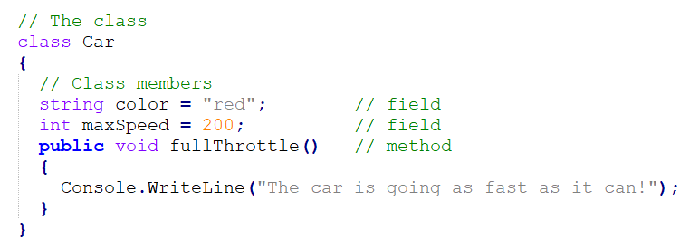
Class Members
Fields and methods inside classes are often referred to as “Class Members“.
Create a Car class with three class members: two fields and one method.

Slide 10
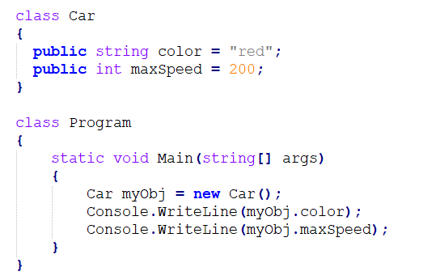
Fields
Variables inside a class are called fields, and you can access them by creating an object of the class, and by using the dot syntax (.).
The following example will create an object of the Car class, with the name myObj. Then we print the value of the fields color and maxSpeed:

Slide 11
Object Methods
Methods are used to perform certain actions.
Methods normally belong to a class, and they define how an object of a class behaves.
Just like with fields, you can access methods with the dot syntax. However, note that the method must be public. And remember that we use the name of the method followed by two parentheses () and a semicolon ; to call (execute) the method:

Slide 12
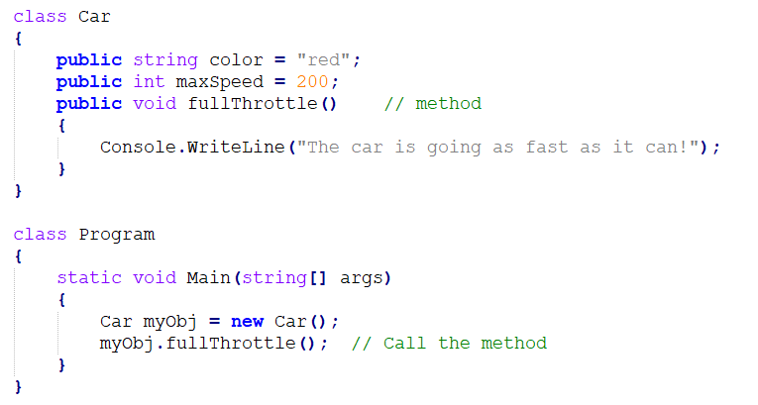

Slide 13
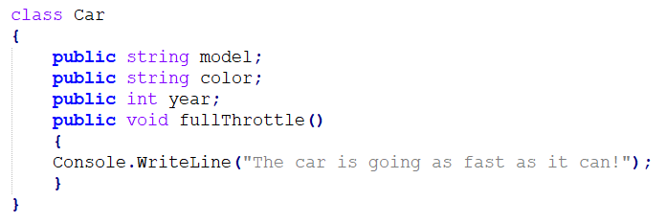
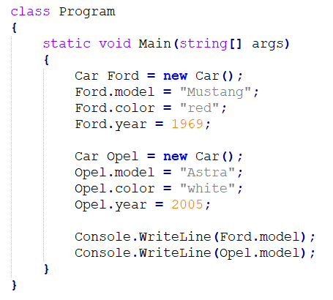
Use Multiple Classes
we can use multiple classes for better organization (one for fields and methods, and another one for execution).

Slide 14
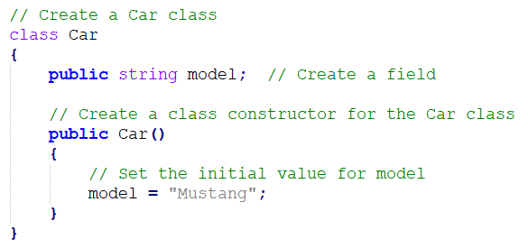
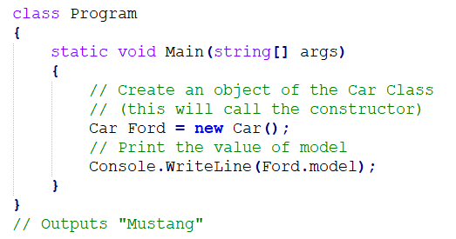
Constructors
A constructor is a special method that is used to initialize objects.
The advantage of a constructor, is that it is called when an object of a class is created. It can be used to set initial values for fields.

Slide 15
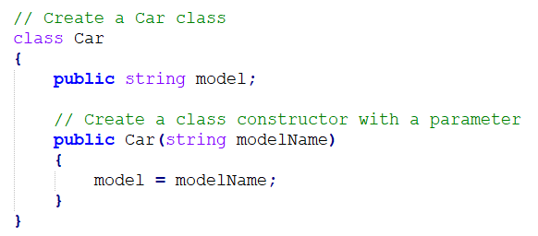
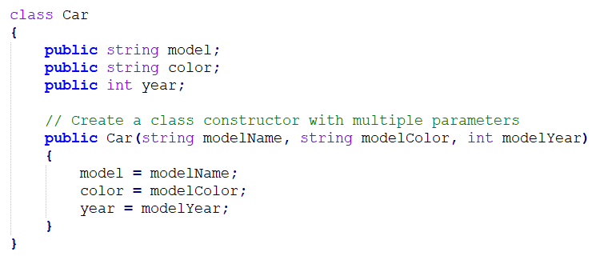
Constructor Parameters

Slide 16
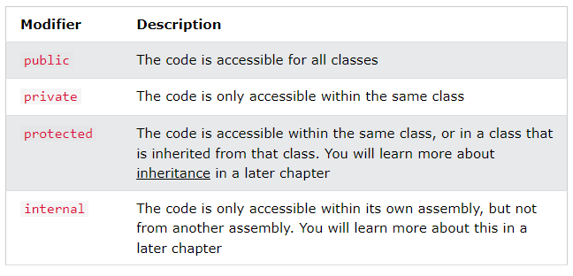
Access Modifiers
The public keyword is an access modifier, which is used to set the access level/visibility for classes, fields, methods and properties.
C# has the following access modifiers.

Slide 17
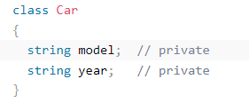
Why Access Modifiers?
To control the visibility of class members (the security level of each individual class and class member).
To achieve "Encapsulation" - which is the process of making sure that "sensitive" data is hidden from users. This is done by declaring fields as private. You will learn more about this in the next chapter.
Note: By default, all members of a class are private if you don't specify an access modifier:

Slide 18
Properties (Get and Set) and Encapsulation
The meaning of Encapsulation, is to make sure that "sensitive" data is hidden from users. To achieve this, you must:
declare fields/variables as private
provide public get and set methods, through properties, to access and update the value of a private field

Slide 19
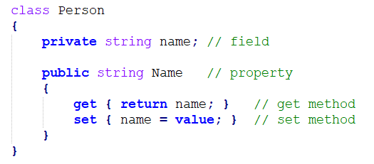
Properties
The private variables can only be accessed within the same class (an outside class has no access to it).
However, sometimes we need to access them - and it can be done with properties.
A property is like a combination of a variable and a method, and it has two methods: a get and a set method:

Slide 20
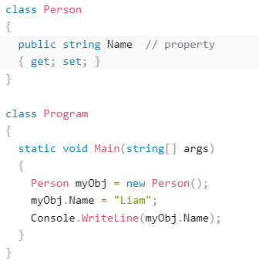
Automatic Properties (Short Hand)
C# also provides a way to use short-hand / automatic properties, where you do not have to define the field for the property, and you only have to write get; and set; inside the property.
The following example will produce the same result as the example above. The only difference is that there is less code:

Slide 21
Why Encapsulation?
Better control of class members (reduce the possibility of yourself (or others) to mess up the code)
Fields can be made read-only (if you only use the get method), or write-only (if you only use the set method)
Flexible: the programmer can change one part of the code without affecting other parts
Increased security of data

Slide 22
Inheritance (Derived and Base Class)
In C#, it is possible to inherit fields and methods from one class to another. We group the "inheritance concept" into two categories:
Derived Class (child) - the class that inherits from another class
Base Class (parent) - the class being inherited from
To inherit from a class, use the : symbol.
In the example, the Car class (child) inherits the fields and methods from the Vehicle class (parent).
The sealed Keyword
If you don't want other classes to inherit from a class, use the sealed keyword.

Slide 23

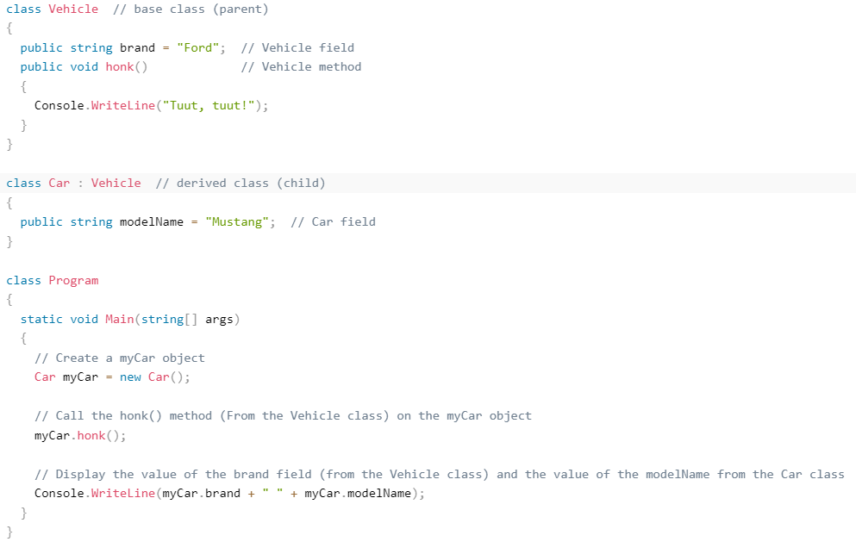

Slide 24
Polymorphism and Overriding Methods
Polymorphism means "many forms", and it occurs when we have many classes that are related to each other by inheritance.
Like we specified in the previous chapter; Inheritance lets us inherit fields and methods from another class. Polymorphism uses those methods to perform different tasks. This allows us to perform a single action in different ways.
For example, think of a base class called Animal that has a method called animalSound(). Derived classes of Animals could be Pigs, Cats, Dogs, Birds - And they also have their own implementation of an animal sound (the pig oinks, and the cat meows, etc.):

Slide 25
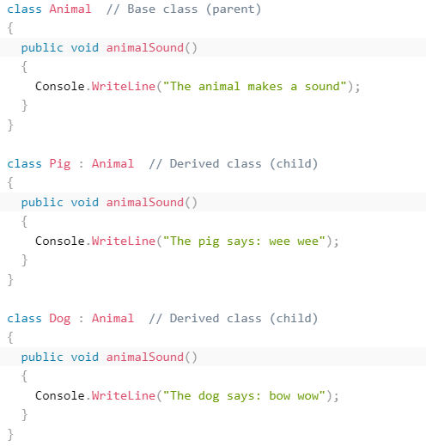
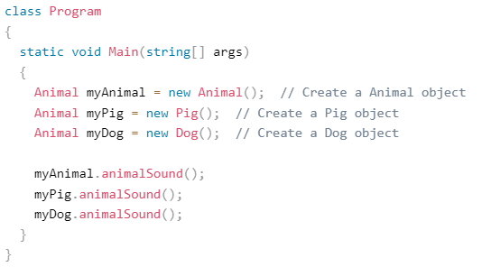

Slide 26
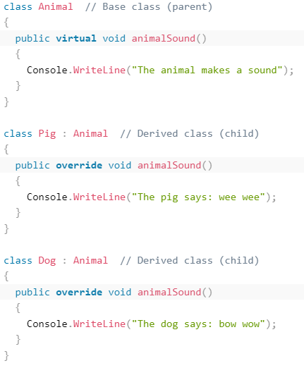
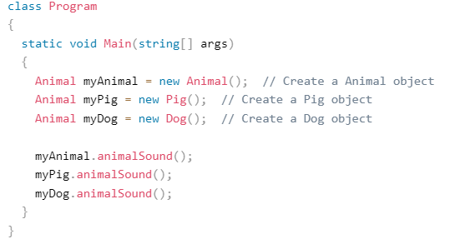
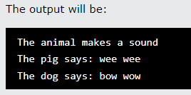

Slide 27
Abstraction - Abstract Classes and Methods
Data abstraction is the process of hiding certain details and showing only essential information to the user.
Abstraction can be achieved with either abstract classes or interfaces (which you will learn more about in the next chapter).
The abstract keyword is used for classes and methods:
Abstract class: is a restricted class that cannot be used to create objects (to access it, it must be inherited from another class).
Abstract method: can only be used in an abstract class, and it does not have a body. The body is provided by the derived class (inherited from).
An abstract class can have both abstract and regular methods:

Slide 28
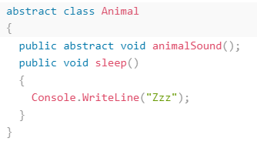
To access the abstract class, it must be inherited from another class.

Slide 29
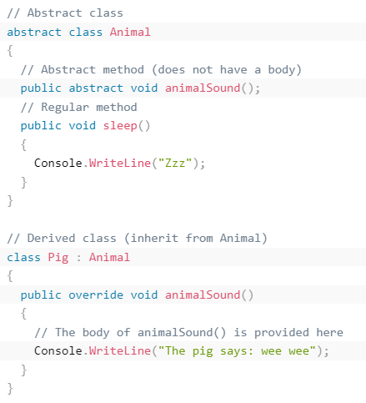
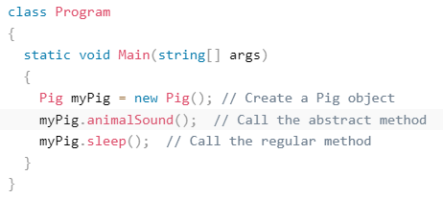

Slide 30
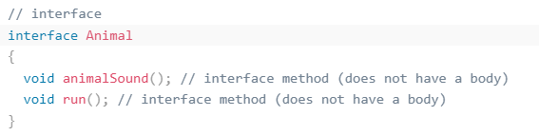
Interfaces
Another way to achieve abstraction in C# is with interfaces.
An interface is a completely "abstract class", which can only contain abstract methods and properties (with empty bodies).

Slide 31
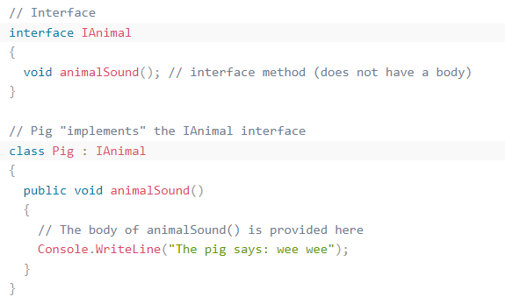
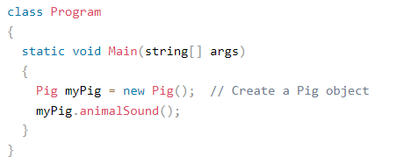

Slide 32
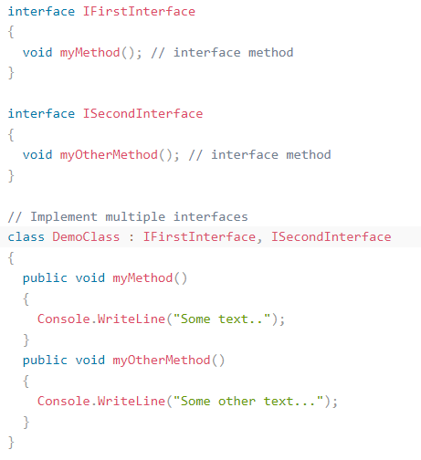
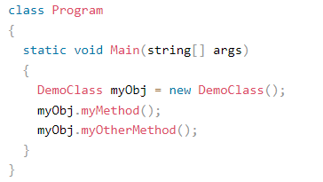
Multiple Interfaces

Slide 33
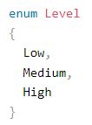

Enums
An enum is a special "class" that represents a group of constants (unchangeable/read-only variables).
To create an enum, use the enum keyword (instead of class or interface), and separate the enum items with a comma.

Slide 34
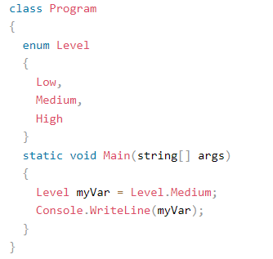

Enum inside a Class
You can also have an enum inside a class.

Slide 35
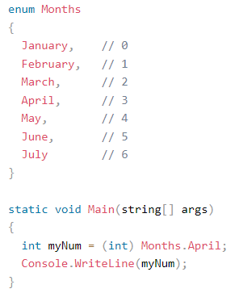

Enum Values
By default, the first item of an enum has the value 0. The second has the value 1, and so on.
To get the integer value from an item, you must explicitly convert the item to an int.

Slide 36
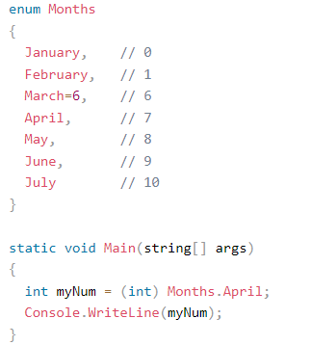

Enum Values
You can also assign your own enum values, and the next items will update their numbers accordingly.

Slide 37
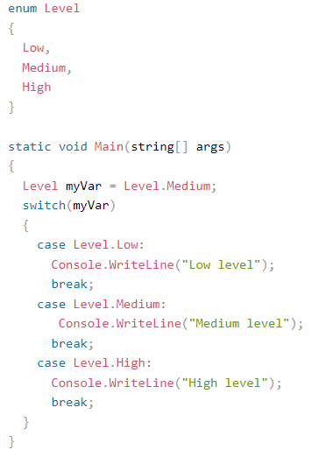

Enum in a Switch Statement
Enums are often used in switch statements to check for corresponding values.

Slide 38

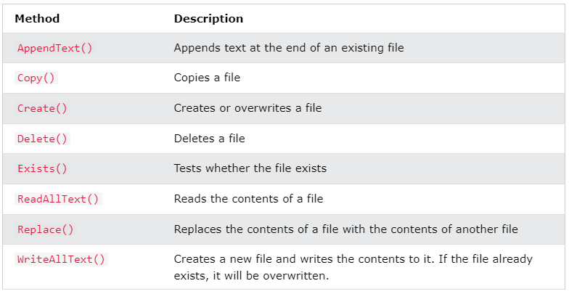
Files
The File class from the System.IO namespace, allows us to work with files.

Slide 39
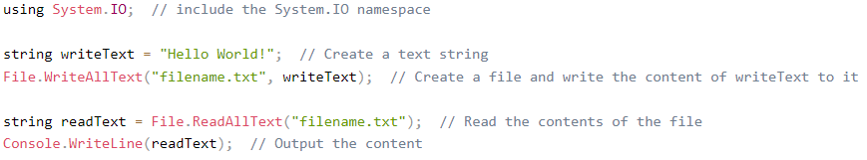

Write To a File and Read It
In the following example, we use the WriteAllText() method to create a file named "filename.txt" and write some content to it. Then we use the ReadAllText() method to read the contents of the file.

Slide 40
Exceptions – Try .. Catch
When executing C# code, different errors can occur: coding errors made by the programmer, errors due to wrong input, or other unforeseeable things.
When an error occurs, C# will normally stop and generate an error message. The technical term for this is: C# will throw an exception (throw an error).

Slide 41
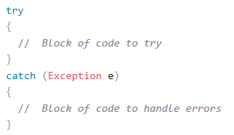
Try .. Catch
The try statement allows you to define a block of code to be tested for errors while it is being executed.
The catch statement allows you to define a block of code to be executed, if an error occurs in the try block.
The try and catch keywords come in pairs.

Slide 42
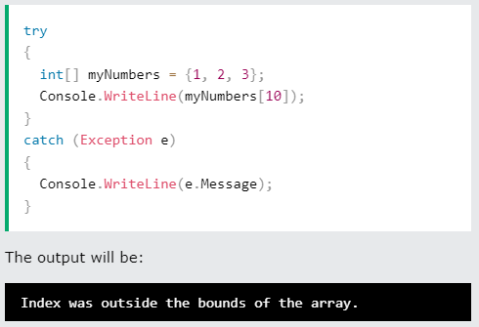
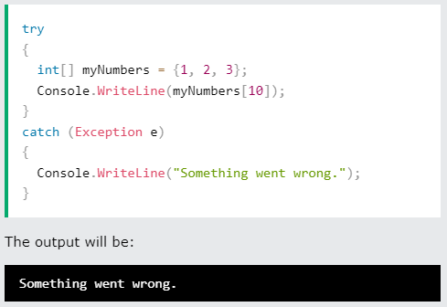

Slide 43
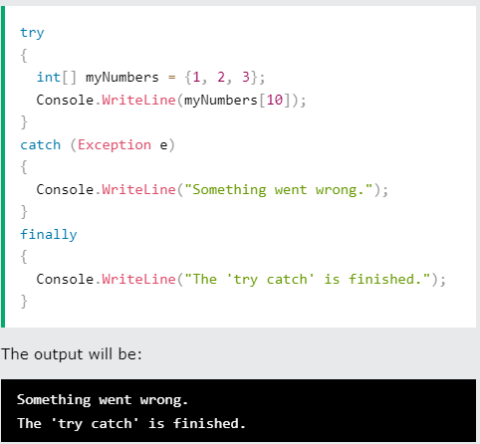
Finally
The finally statement lets you execute code, after try...catch, regardless of the result.

